Slide 1
DSA-210 Term Project
Ege Dolmacı 31263

Slide 2
Research Question
How does economic indicators of a country influence the citizens e-commerce spending habits?

Slide 3
Hypothesis
H1: Countries with higher GDP per capita have higher average order values

Slide 4
Datasets
E-commerce Data
https://www.kaggle.com/datasets/carrie1/ecommerce-data/code
World Development Indicators
https://www.kaggle.com/datasets/theworldbank/world-development-indicators/code

Slide 5
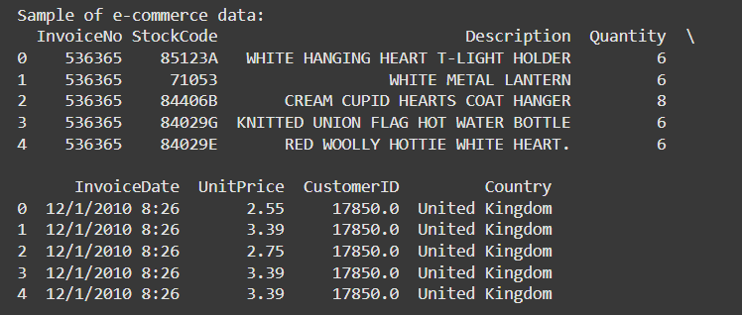
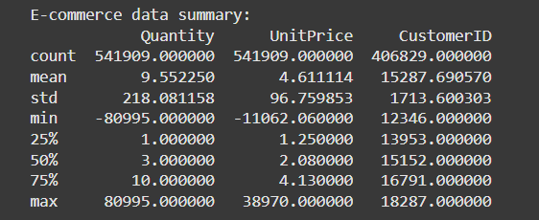
EDA

Slide 6
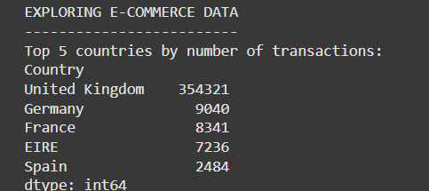
In terms of transactions dataset is little skewed, due to law of large numbers conclusions from UK data might be more healthy.

Slide 7
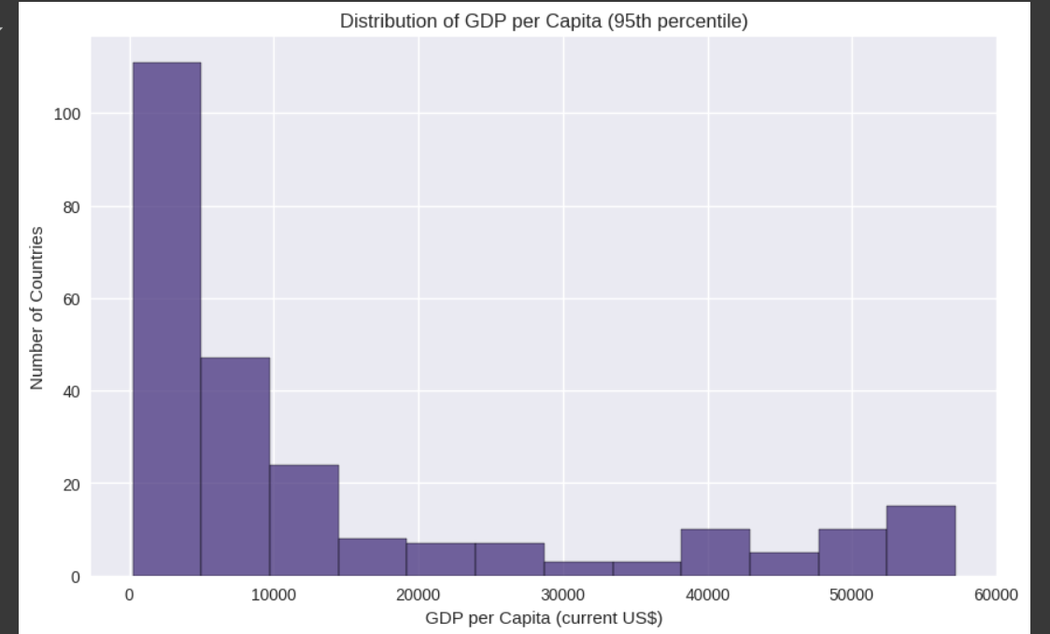
We have less data for high GDP countries this could possibly affect our hypothesis testing.

Slide 8
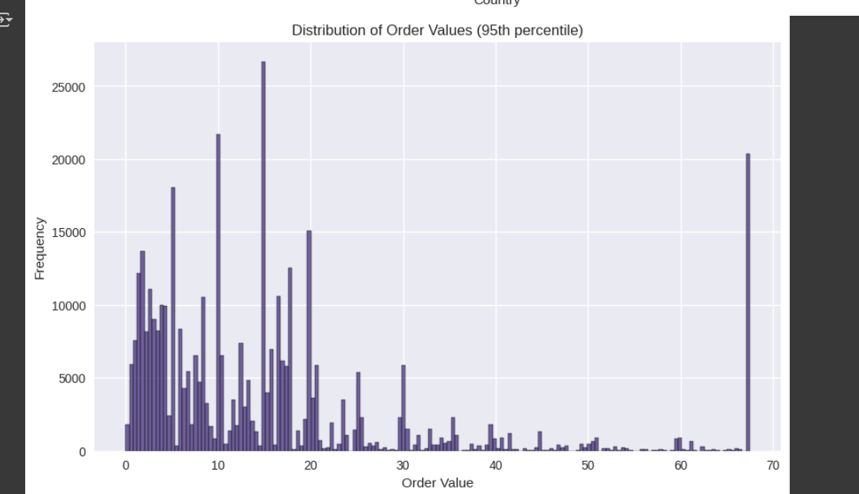
For high order values data distribution is once again not very fair. All these skewed dataset properties should be considered when interpreting the results

Slide 9
I used the stats.pearsonr() function from the SciPy library, for correlation efficient and p-value computation.

Slide 10

Result
This means that since p-value is less than 0.05 We fail to reject null hypothesis. Our evidence is not enough to prove that there is a strong correlation between GDP per capita and order value in e-commerce spendings.

Slide 11
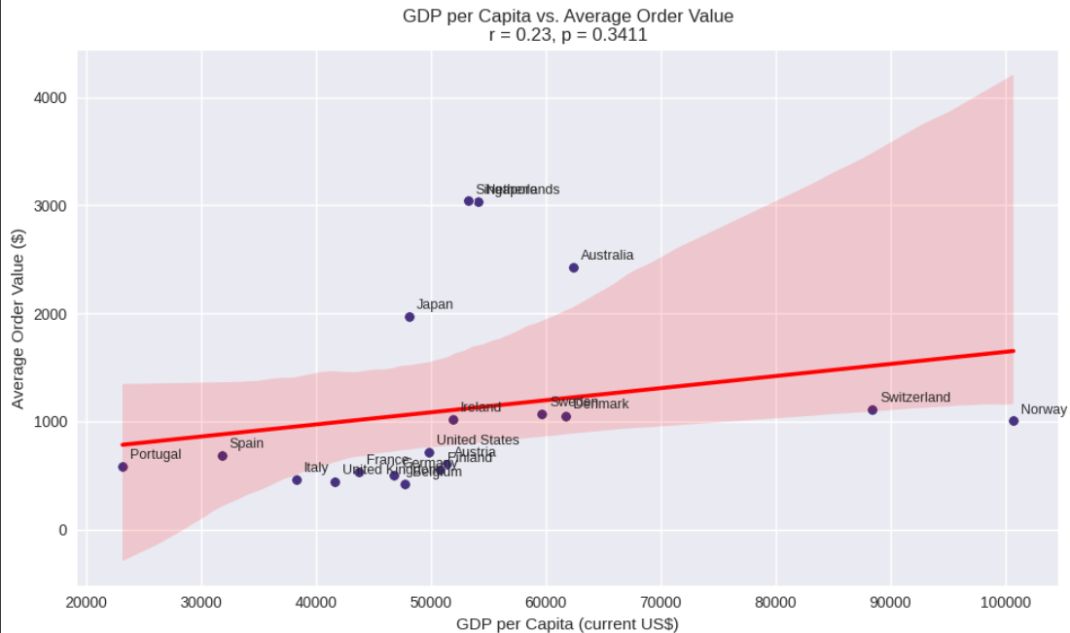
Looking at how datapoints are clustered the line we fit also supports our conclusion. Slope is very small, this almost ensures there is very little correlation.

Slide 12
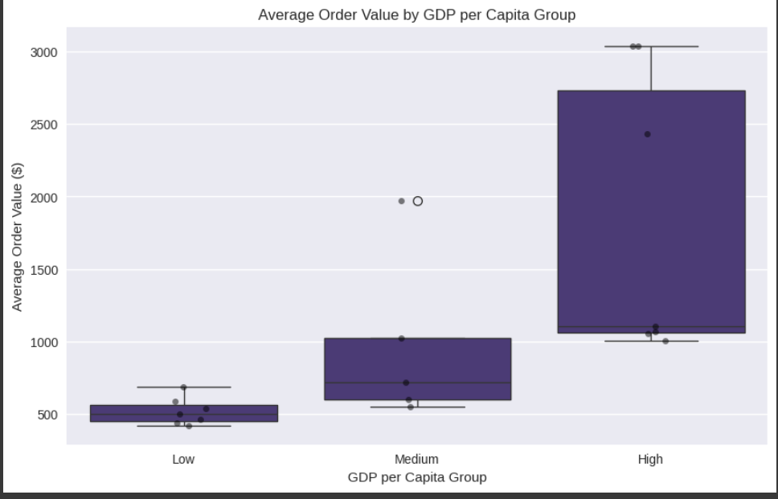
Looking at the data, we can observe clusters are very unbalanced and there are lot of datapoints outside the rectangles which means too many outliers.

